Slide 1
Processes

Slide 2
Processes
Process Concept
Process Scheduling
Operations on Processes
Interprocess Communication
Examples of IPC Systems
Communication in Client-Server Systems

Slide 3
Objectives
To introduce the notion of a process -- a program in execution, which forms the basis of all computation
To describe the various features of processes, including scheduling, creation and termination, and communication
To describe communication in client-server systems

Slide 4
Process Concept
An operating system executes a variety of programs:
Batch system – jobs
Time-shared systems – user programs or tasks
Textbook uses the terms job and process almost interchangeably
Process – a program in execution; process execution must progress in sequential fashion
A process includes:
program counter
stack
data section

Slide 5
The Process
Multiple parts
The program code, also called text section
Current activity including program counter, processor registers
Stack containing temporary data
Function parameters, return addresses, local variables
Data section containing global variables
Heap containing memory dynamically allocated during run time
Program is passive entity, process is active
Program becomes process when executable file loaded into memory
Execution of program started via GUI mouse clicks, command line entry of its name, etc
One program can be several processes
Consider multiple users executing the same program

Slide 6
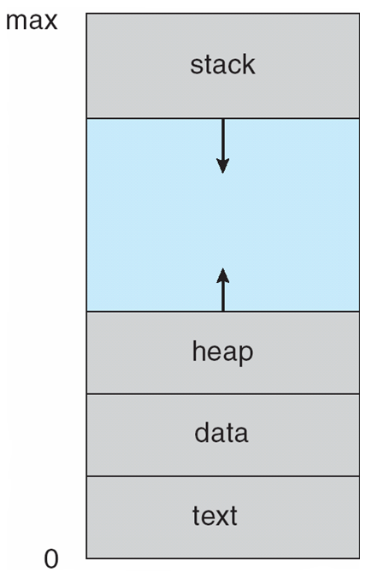
Process in Memory

Slide 7
Process State
As a process executes, it changes state
new: The process is being created
running: Instructions are being executed
waiting: The process is waiting for some event to occur
ready: The process is waiting to be assigned to a processor
terminated: The process has finished execution

Slide 8
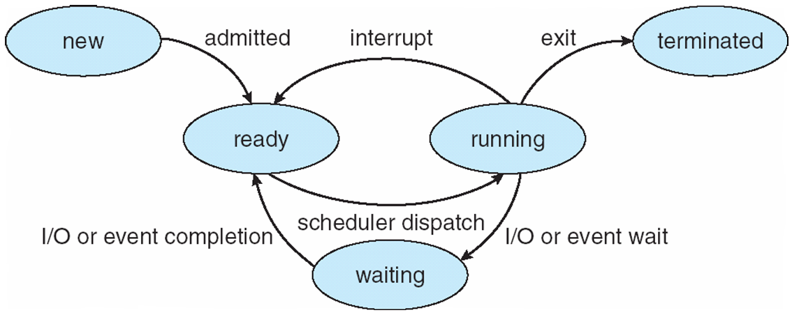
Diagram of Process State

Slide 9
Process Control Block (PCB)
Information associated with each process
Process state
Program counter
CPU registers
CPU scheduling information
Memory-management information
Accounting information
I/O status information

Slide 10
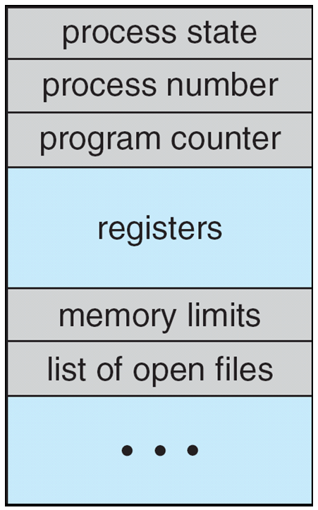
Process Control Block (PCB)

Slide 11
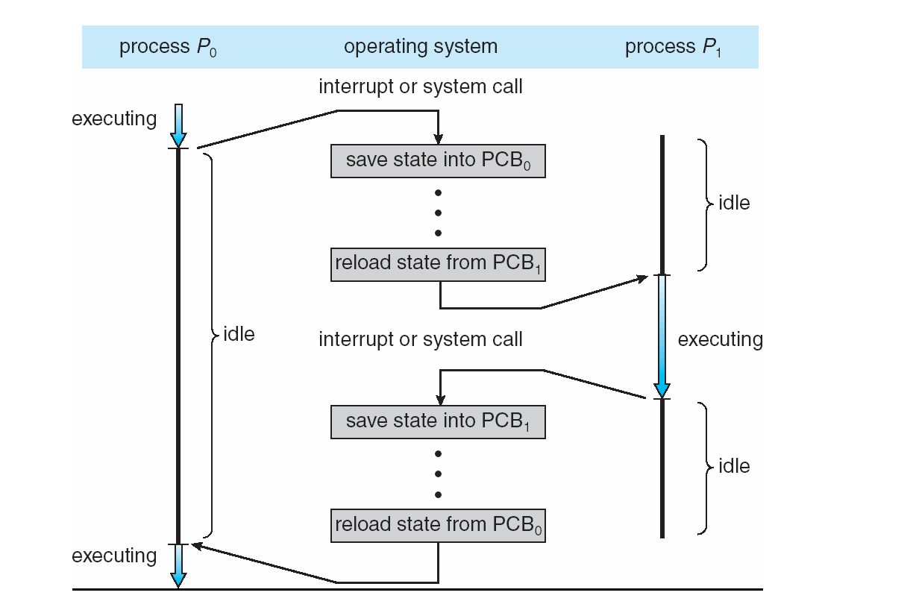
CPU Switch From Process to Process

Slide 12
Process Scheduling
Maximize CPU use, quickly switch processes onto CPU for time sharing
Process scheduler selects among available processes for next execution on CPU
Maintains scheduling queues of processes
Job queue – set of all processes in the system
Ready queue – set of all processes residing in main memory, ready and waiting to execute
Device queues – set of processes waiting for an I/O device
Processes migrate among the various queues

Slide 13
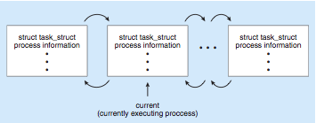
Process Representation in Linux
Represented by the C structure task_struct pid t pid; /* process identifier */ long state; /* state of the process */ unsigned int time slice /* scheduling information */ struct task struct *parent; /* this process’s parent */ struct list head children; /* this process’s children */ struct files struct *files; /* list of open files */ struct mm struct *mm; /* address space of this pro */

Slide 14
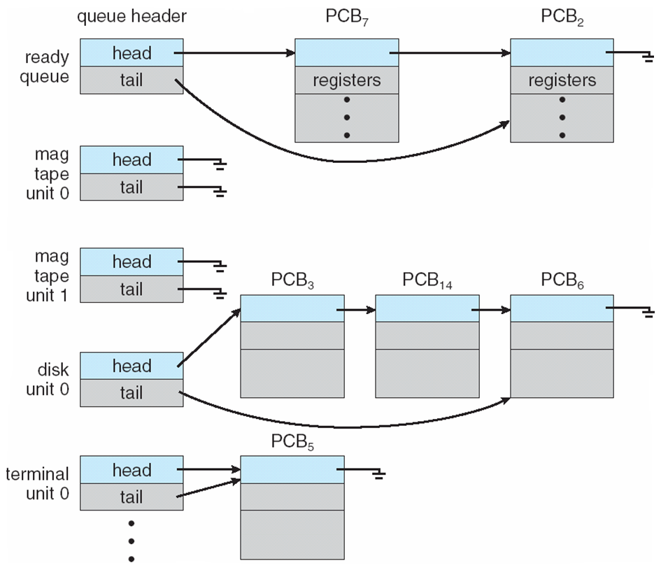
Ready Queue And Various I/O Device Queues

Slide 15
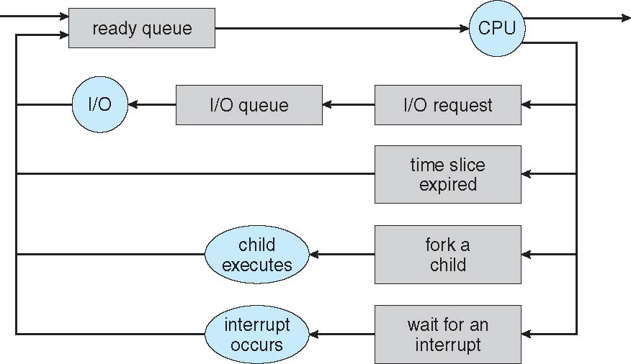
Representation of Process Scheduling

Slide 16
Schedulers
Long-term scheduler (or job scheduler) – selects which processes should be brought into the ready queue
Short-term scheduler (or CPU scheduler) – selects which process should be executed next and allocates CPU
Sometimes the only scheduler in a system

Slide 17
Schedulers (Cont.)
Short-term scheduler is invoked very frequently (milliseconds) ⇒ (must be fast)
Long-term scheduler is invoked very infrequently (seconds, minutes) ⇒ (may be slow)
The long-term scheduler controls the degree of multiprogramming
Processes can be described as either:
I/O-bound process – spends more time doing I/O than computations, many short CPU bursts
CPU-bound process – spends more time doing computations; few very long CPU bursts

Slide 18
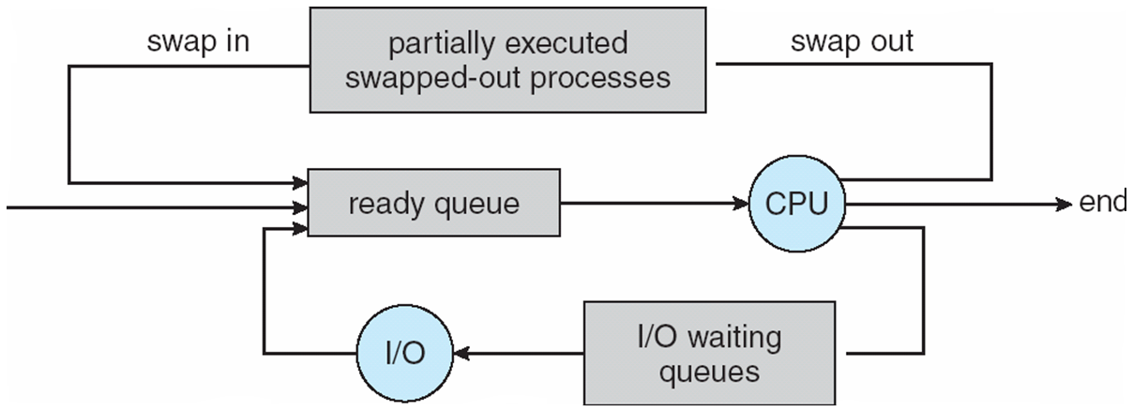
Addition of Medium Term Scheduling

Slide 19
Context Switch
When CPU switches to another process, the system must save the state of the old process and load the saved state for the new process via a context switch.
Context of a process represented in the PCB
Context-switch time is overhead; the system does no useful work while switching
The more complex the OS and the PCB -> longer the context switch
Time dependent on hardware support
Some hardware provides multiple sets of registers per CPU -> multiple contexts loaded at once

Slide 20
Process Creation
Parent process create children processes, which, in turn create other processes, forming a tree of processes
Generally, process identified and managed via a process identifier (pid)
Resource sharing
Parent and children share all resources
Children share subset of parent’s resources
Parent and child share no resources
Execution
Parent and children execute concurrently
Parent waits until children terminate

Slide 21
Process Creation (Cont.)
Address space
Child duplicate of parent
Child has a program loaded into it
UNIX examples
fork system call creates new process
exec system call used after a fork to replace the process’ memory space with a new program

Slide 22
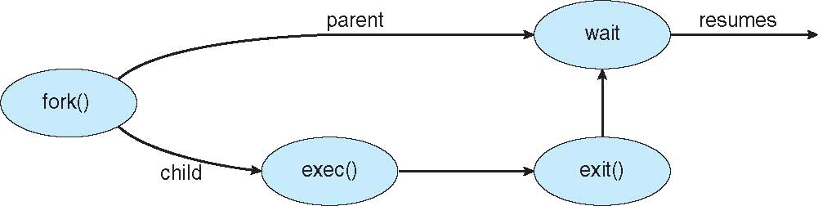
Process Creation

Slide 23
C Program Forking Separate Process
#include <sys/types.h>
#include <studio.h>
#include <unistd.h>
int main()
{
pid_t pid;
/* fork another process */
pid = fork();
if (pid < 0) { /* error occurred */
fprintf(stderr, "Fork Failed");
return 1;
}
else if (pid == 0) { /* child process */
execlp("/bin/ls", "ls", NULL);
}
else { /* parent process */
/* parent will wait for the child */
wait (NULL);
printf ("Child Complete");
}
return 0;
}

Slide 24
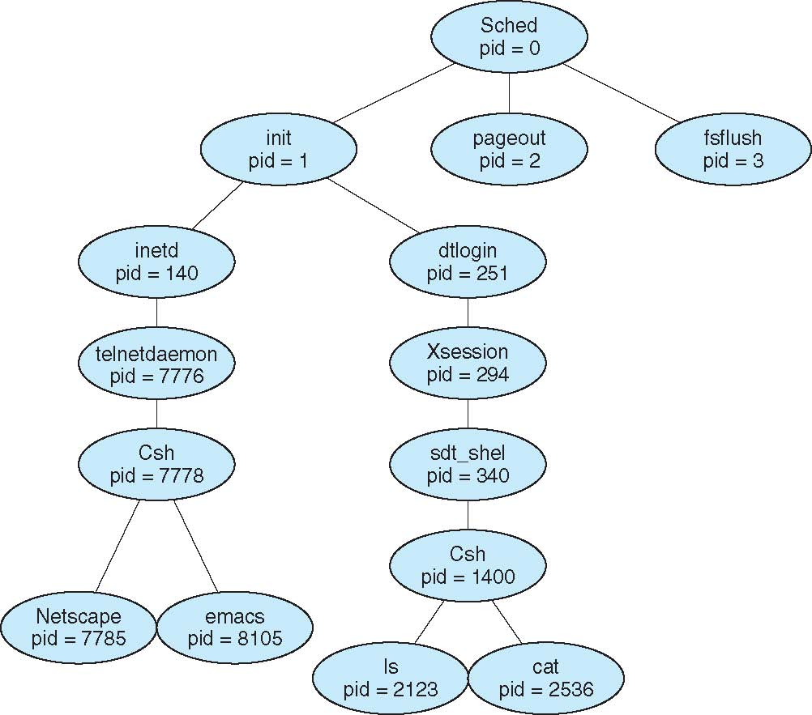
A Tree of Processes on Solaris

Slide 25
Process Termination
Process executes last statement and asks the operating system to delete it (exit)
Output data from child to parent (via wait)
Process’ resources are deallocated by operating system
Parent may terminate execution of children processes (abort)
Child has exceeded allocated resources
Task assigned to child is no longer required
If parent is exiting
Some operating systems do not allow child to continue if its parent terminates
All children terminated - cascading termination

Slide 26
End of Chapter 3

